Slide 1
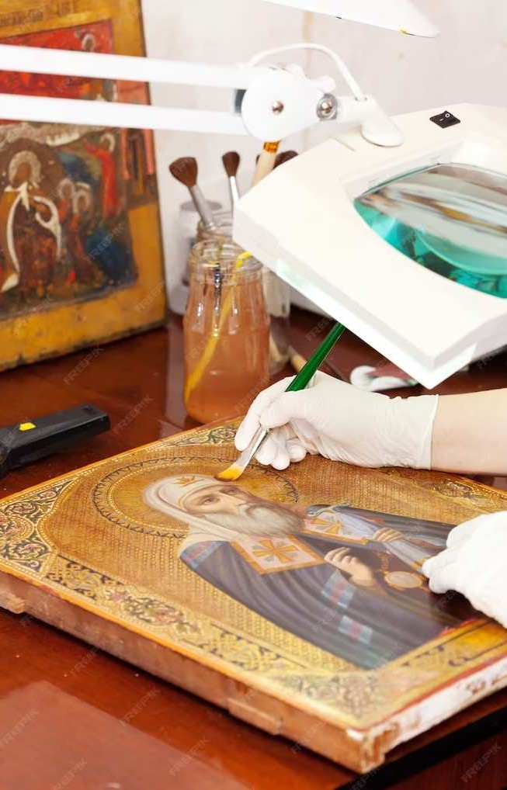
Harnessing the Power of CycleGAN to Convert Images into Works from Artists of Old

Slide 2
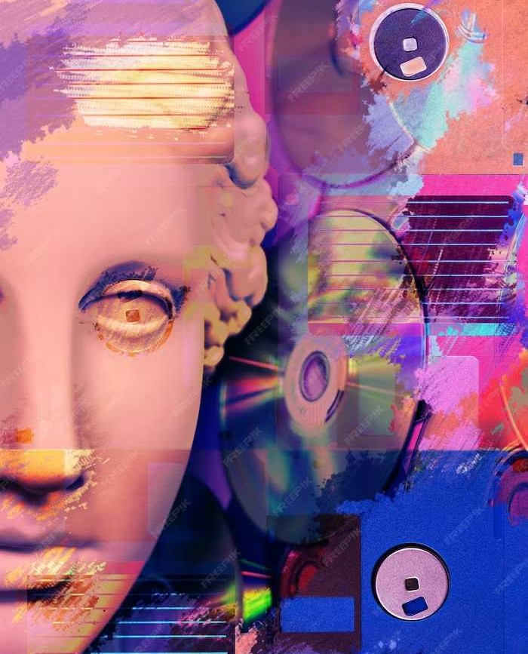
Introduction
Welcome to the world of Image Transformation using CycleGAN. This presentation will explore the potential of CycleGAN in converting ordinary images into masterpieces. We will delve into the technical aspects and creative applications of this cutting- edge technology.

Slide 3
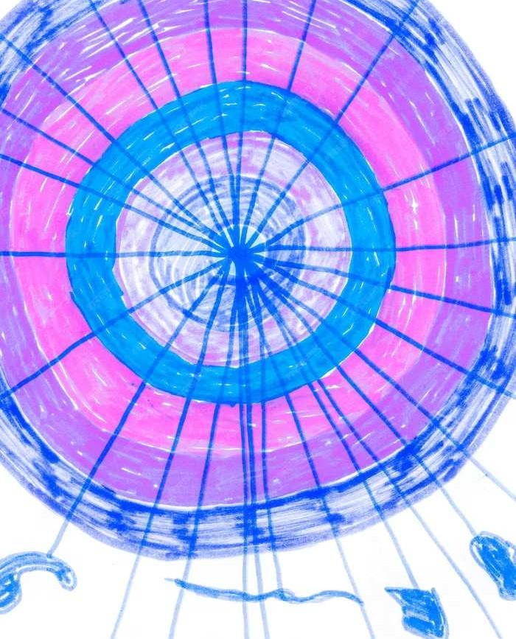
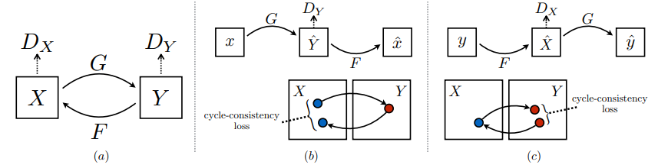
Understanding CycleGAN
CycleGAN is a type of generative adversarial network (GAN) that can learn to transform images from one domain to another without paired training data. It consists of two discriminators and two generators working in a cycle.
Simplified workflow of CycleGAN

Slide 4
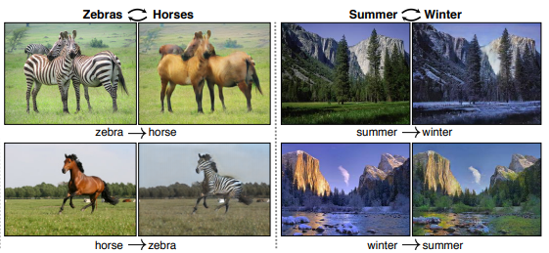
An illustrative example
The two discriminators and generator pairs can be explained as follows:
A given image of horses when transformed into an image of zebras should yield the same result as an image of zebras transformed into an image of horses.

Slide 5

Training Process
The training process of CycleGAN involves minimizing adversarial losses and cycle consistency losses. This enables the network to learn the mapping between two domains and ensure that the transformation is
consistent.

Slide 6
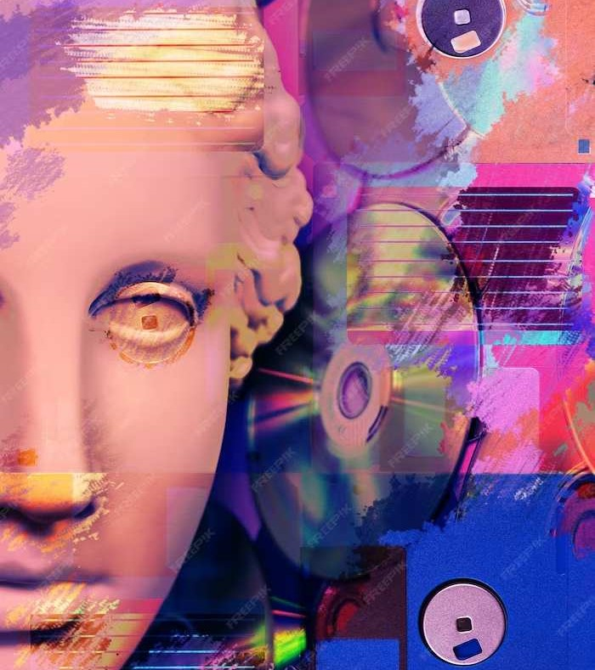
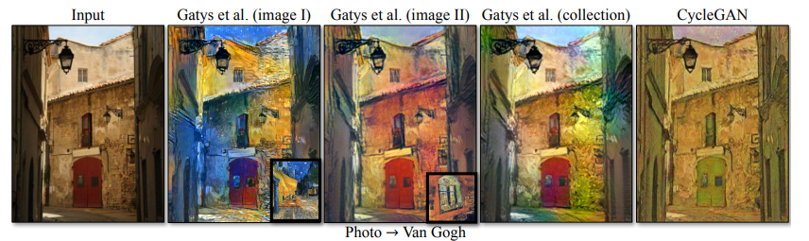
Artistic Applications
CycleGAN has been widely used in various artistic applications, such as style transfer, photo-to-painting conversion, and image enhancement. It allows artists and designers to explore new creative possibilities.
Example

Slide 7

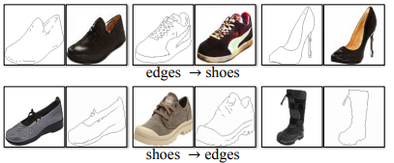
Industry Integration
The integration of CycleGAN in industries such as fashion design, ﬁlm production, and digital art showcases its potential to revolutionize visual storytelling and aesthetic innovation. By leveraging CycleGAN, industries can elevate their creative processes and offer unique experiences to their
audiences.
How product designing and advertisement can be simplified

Slide 8

Ethical Considerations
As with any transformative technology, the use of CycleGAN raises important ethical considerations regarding copyright, cultural appropriation, and misuse. It is essential to approach its applications with ethical awareness.

Slide 9
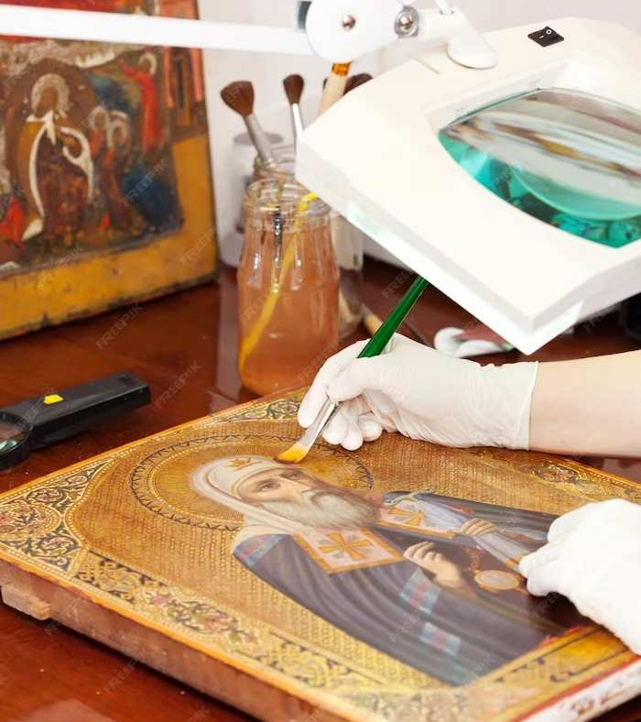

Real-world E amples
Several real-world examples demonstrate the impact of CycleGAN in art restoration, cultural preservation, and creative expression. These examples highlight the potential of CycleGAN in transforming the art
world.

Slide 10
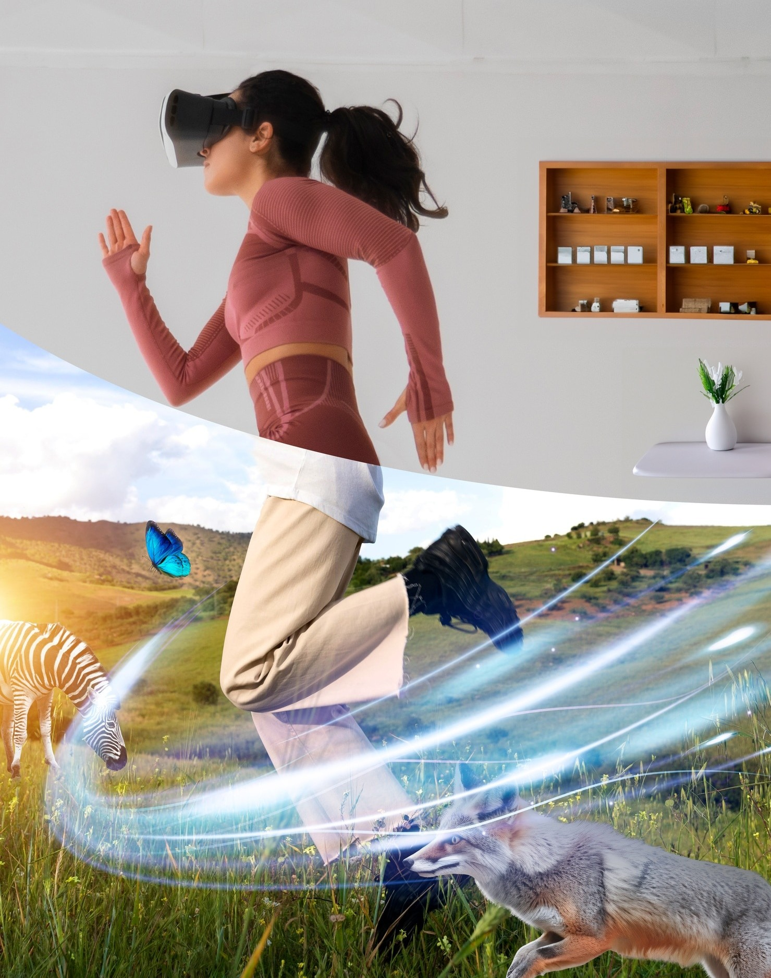
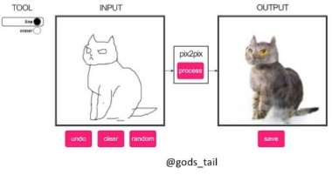
Future Possibilities
Looking ahead, the future possibilities of CycleGAN extend to augmented reality, interactive art installations, and personalized visual experiences. It is poised to revolutionize the way we perceive and interact with visual content.
Example for interactive art installations

Slide 11

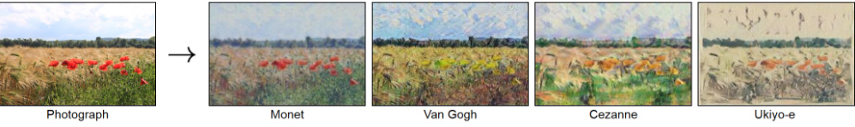
Challenges and Opportunities
The widespread adoption of CycleGAN presents both challenges and opportunities in the art world. Embracing these challenges and seizing the opportunities will shape the future of artistic transformation and creative innovation.
What we achieved using CycleGAN model

Slide 12
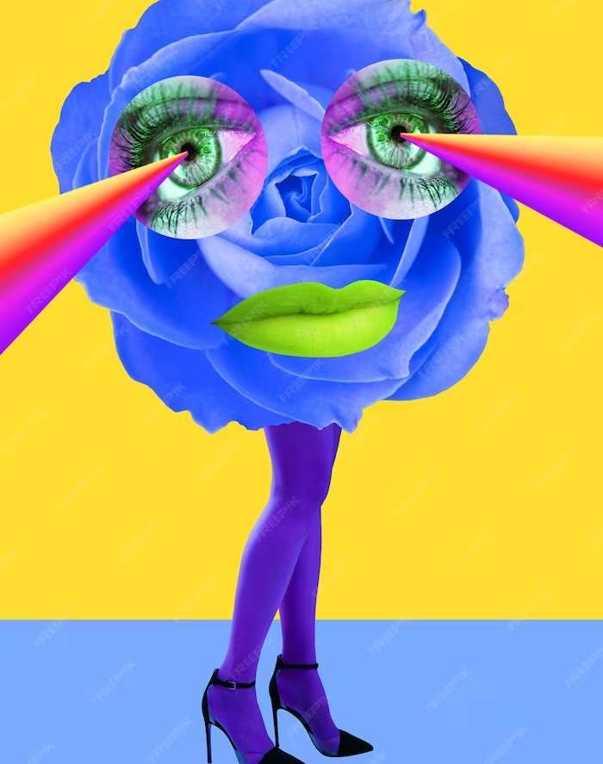
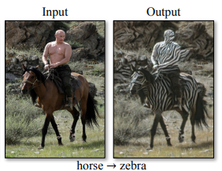
Impact on Visual Culture
CycleGAN's impact on visual culture is profound, inﬂuencing the way we perceive and engage with images. It fosters a culture of artistic diversity and experimental creativity, redeﬁning the boundaries of visual representation.
The current version of CycleGAN is not perfect and thus leads to some unique results…

Slide 13
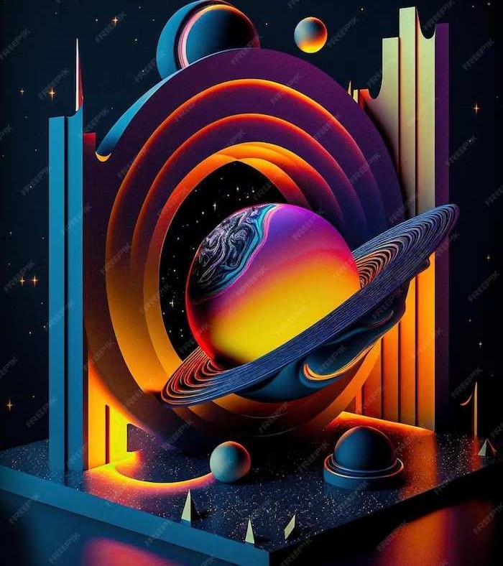
Exploring New Frontiers
As we explore the new frontiers of artistic transformation with CycleGAN, it is essential to embrace innovation, collaboration, and ethical responsibility. Together, we can harness the full potential of this transformative technology.

Slide 14
Conclusion
In conclusion, CycleGAN offers a remarkable avenue for artistic transformation, enabling the conversion of images into masterpieces. As we navigate the complexities and possibilities of this technology, let us strive to uphold creativity, ethics, and innovation.

Slide 15
Thanks You!
Submitted by –
102116090 (Pranav Sharma)

